Slide 1



Maze Solver
A Maze Solver that generates random mazes and solve using search algorithms
1. [Amrita Biswas] [2022015642]
2. [Md. Muhtasim Fuad Nafim] [2533150042]
3. [Maheer Diyan Shuddho] [2533366042]
4. [Tanjerul Abedin] [2531408642]
Group 05 | Automated Maze Solver
Final Presentation

Slide 2

Project Overview
SCOPE & STRATEGIC SIGNIFICANCE
Problem Statement
Low-Level Efficiency
Pathfinding and procedural generation are basic problems within computer science. This project provides a closed system optimized to:
1. Create a valid, solvable maze with random logic.
2. Find the solution path on your own by traversing graphs.
3. Visualize the result in a C environment that is safe in memory.
Direct memory management using pointers and structs to ensure minimal overhead.
Algorithm Design
Implementation of Randomized DFS and Backtracking heuristics for optimal maze creation.
Group 05 | Automated Maze Solver
Page 2/8

Slide 3



System Architecture
TWO-PHASE EXECUTION STRATEGY
Phase 1: Generation
Phase 2: Solver
Algo: Recursive Backtracker
Algorithm: Depth-first search (DFS)
•
Starts with a solid grid (all walls).
•
Passes through the point (1,1).
•
UsFisher-Yates Shuffle is used in order to randomize the direction vectors.es Fisher-Yates Shuffle to randomize direction vectors.
•
Recursively explores neighbors.
•
Employed backtracking in order to unmark all dead-end paths, leaving only the correct solution visible.
•
Guarantees a "Perfect Maze" - no loops, fully connected.
Group 05 | Automated Maze Solver
Page 3/8

Slide 4
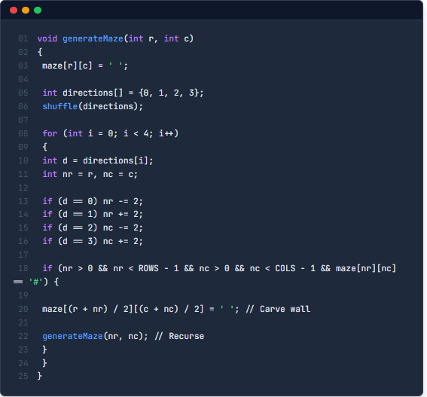
Implementation: Generation
RECURSIVE BACKTRACKING LOGIC
Logic Architecture
Recursion combined with randomization builds into the base generation logic that creates diverse models.
Unbiased shuffle ensures that maze layout is unpredictable and nonlinear.
Stack Usage It uses the call stack to "remember" how to get back when a dead end is reached.
Group 05 | Automated Maze Solver
Page 4/8

Slide 5
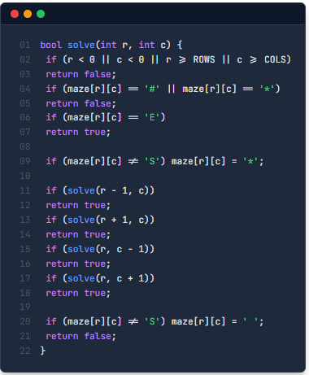
Implementation: Solver
DEPTH-FIRST SEARCH (DFS)
Backtracking Strategy
Cell visiting marks the path, in which case there is backtracking in the event that a cell leads to a dead end.
Insight: This is what helps ensure that the only path that is marked with '*' after completion is the successful path.
Group 05 | Automated Maze Solver
Page 5/8

Slide 6






Data Structures
MEMORY & STATE MANAGEMENT
Global Matrix
Struct Abstraction
Persistence
char maze[ROWS][COLS]
struct Point { int r, c; }
generated_maze.txt
The use of a static 2D array keeps the stack space small, making function calls simpler.
Clean encapsulation of grid coordinates for logical grouping.
Standard I/O Output provides the ability to check the maze state from outside the CLI.
Group 05 | Automated Maze Solver
Page 6/8

Slide 7

Execution & Verification
TERMINAL OUTPUT SIMULATION
Visual Feedback
$ gcc main.c -o maze_solver
[INFO] Compilation successful.
$ ./maze_solver
The project uses ANSI Escape Codes for a rich terminal command line interface.
[INIT] Grid 21x21 allocated.
[GEN] Maze Created.
[SOLVER] Path Found!
Start/End: Green
# # # # # # # # #
# S * * # * # # #
# # # * # * * * #
# # # * * * # E #
Path: Amber/Yellow
Walls: White/Grey
$ _
Group 05 | Automated Maze Solver
Page 7/8

Slide 8
Conclusion: Project Synthesis
The Automated Maze Solver is a success, integrating state-of-the-art procedural generation (Recursive Backtracking) with efficient pathfinding (DFS). The project has proven our competence in optimizing a highly optimized, memory-safe, self-contained system, which implements solutions for fundamental areas of algorithm design, such as efficiency.
Group 05 | Automated Maze Solver
Page 8/8

